Slide 1
Unsupervised Machine Learning

Slide 2
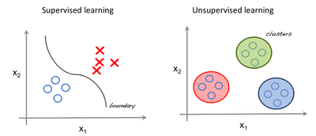
Supervised vs Unsupervised

Slide 3
Terminology
Feature: An input variable used in making predictions.
Predictions: A model’s output when provided with an input example.
Example: One row of a data set. An example contains one or more features and possibly a label.
Label: Result of the feature.

Slide 4
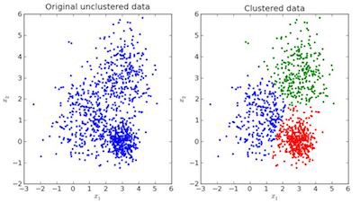
Clustering

Slide 5
Dendrogram
A dendrogram is a diagram that shows the hierarchical relationship between objects. It is most commonly created as an output from hierarchical clustering. The main use of a dendrogram is to work out the best way to allocate objects to clusters.

Slide 6
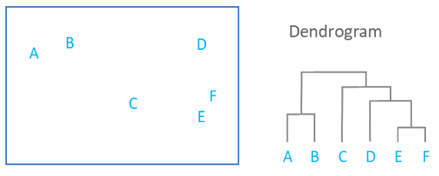
The dendrogram below shows the hierarchical clustering of six observations shown to on the scatterplot to the left.

Slide 7
t-SNE Clustering
t-SNE stands for ”t-distributed stochastic neighbor embedding”.
It maps high dimensional space into a 2 or 3 dimensional space which can be visualized.
Specifically, it models each high-dimensional object by a two- or three-dimensional point in such a way that similar objects are modeled by nearby points and dissimilar objects are modeled by distant points with high probability.

Slide 8
DBSCAN Clustering
DBSCAN (Density-Based Spatial Clustering of Applications with Noise) is a popular clustering algorithm used as an replacement to K-means in predictive analytics.
It doesn’t require that you input the number of clusters in order to run.
But, you have to tune two other parameters.
The scikit-learn implementation provides a default for the eps and min_samples parameters, but you’re generally expected to tune those.
The eps parameter is the maximum distance between two data points to be considered in the same neighborhood.
The min_samples parameter is the minimum amount of data points in a neighborhood to be considered a cluster.

